Slide 1
FAÇADE PATTERN
Tony Mulenga Chibesakunda

Slide 2
Definition
The façade pattern provides a unified interface to a set of interfaces in a subsystem.
Façade defines a higher-level interface that makes the subsystem easier to use.
This pattern hides all the complexity of one or more classes behind a clean well-lit façade.
A façade decouples a client from a subsystem of components
It is a structural design pattern.

Slide 3
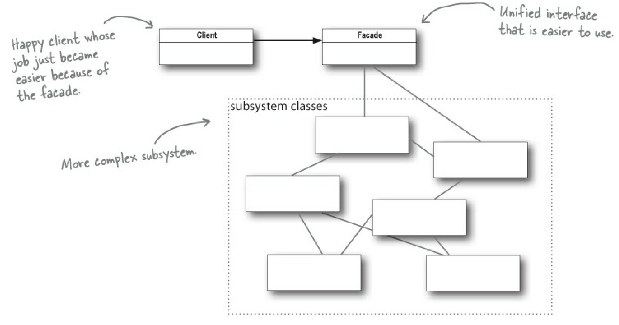
Definition(Cont’d)

Slide 4
Example
Building your own home theater
After research, things to be assembled are:
Players (DVD, CD and Radio)
Projection video system
An automated screen
Surround sound (amplifier)
Popcorn maker
Components put together that will form classes:
DvdPlayer
CdPlayer
Amplifier

Slide 5
Example (Cont’d)
Projector
Tuner Screen PopcornMaker
Theater Lights
Tasks needed to watch a movie:
Turn on the popcorn popper
Start the popper popping
Dim the lights
Put the screen down
Turn the projector on
Set the projector input to DVD
Put the projector on wide-screen mode

Slide 6
Example (Cont’d)
Turn the sound amplifier on
Set the amplifier to DVD input
Set the amplifier to surround sound
Set the amplifier volume to medium (5)
Turn the DVD player on
Start the DVD player playing
Let’s check out those same tasks in terms of the classes and the method calls needed to perform them:

Slide 7
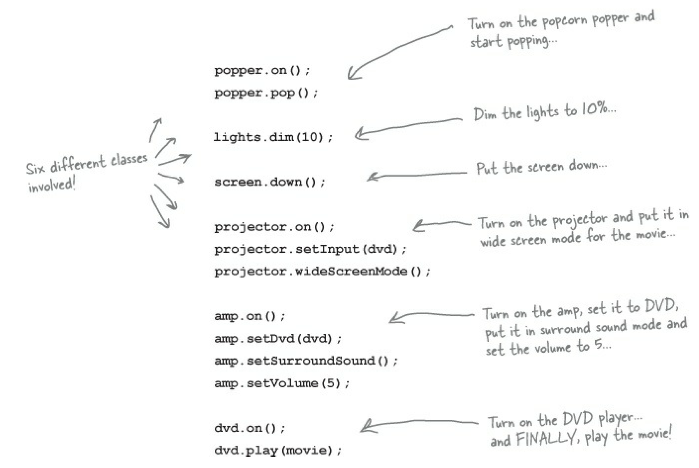
Example (Cont’d)

Slide 8
Example (Cont’d)
If the movie is over, the tasks will be done all over again but in reverse order.
Complexity in using the home theater system.
Implementation of Façade Pattern:
Takes a complex system and make it easier to use by implementing a façade class that provides one, more reasonable interface.
Façade class treats the home theater components as a subsystem, and calls on the subsystem to implement its watchMovie() method

Slide 9
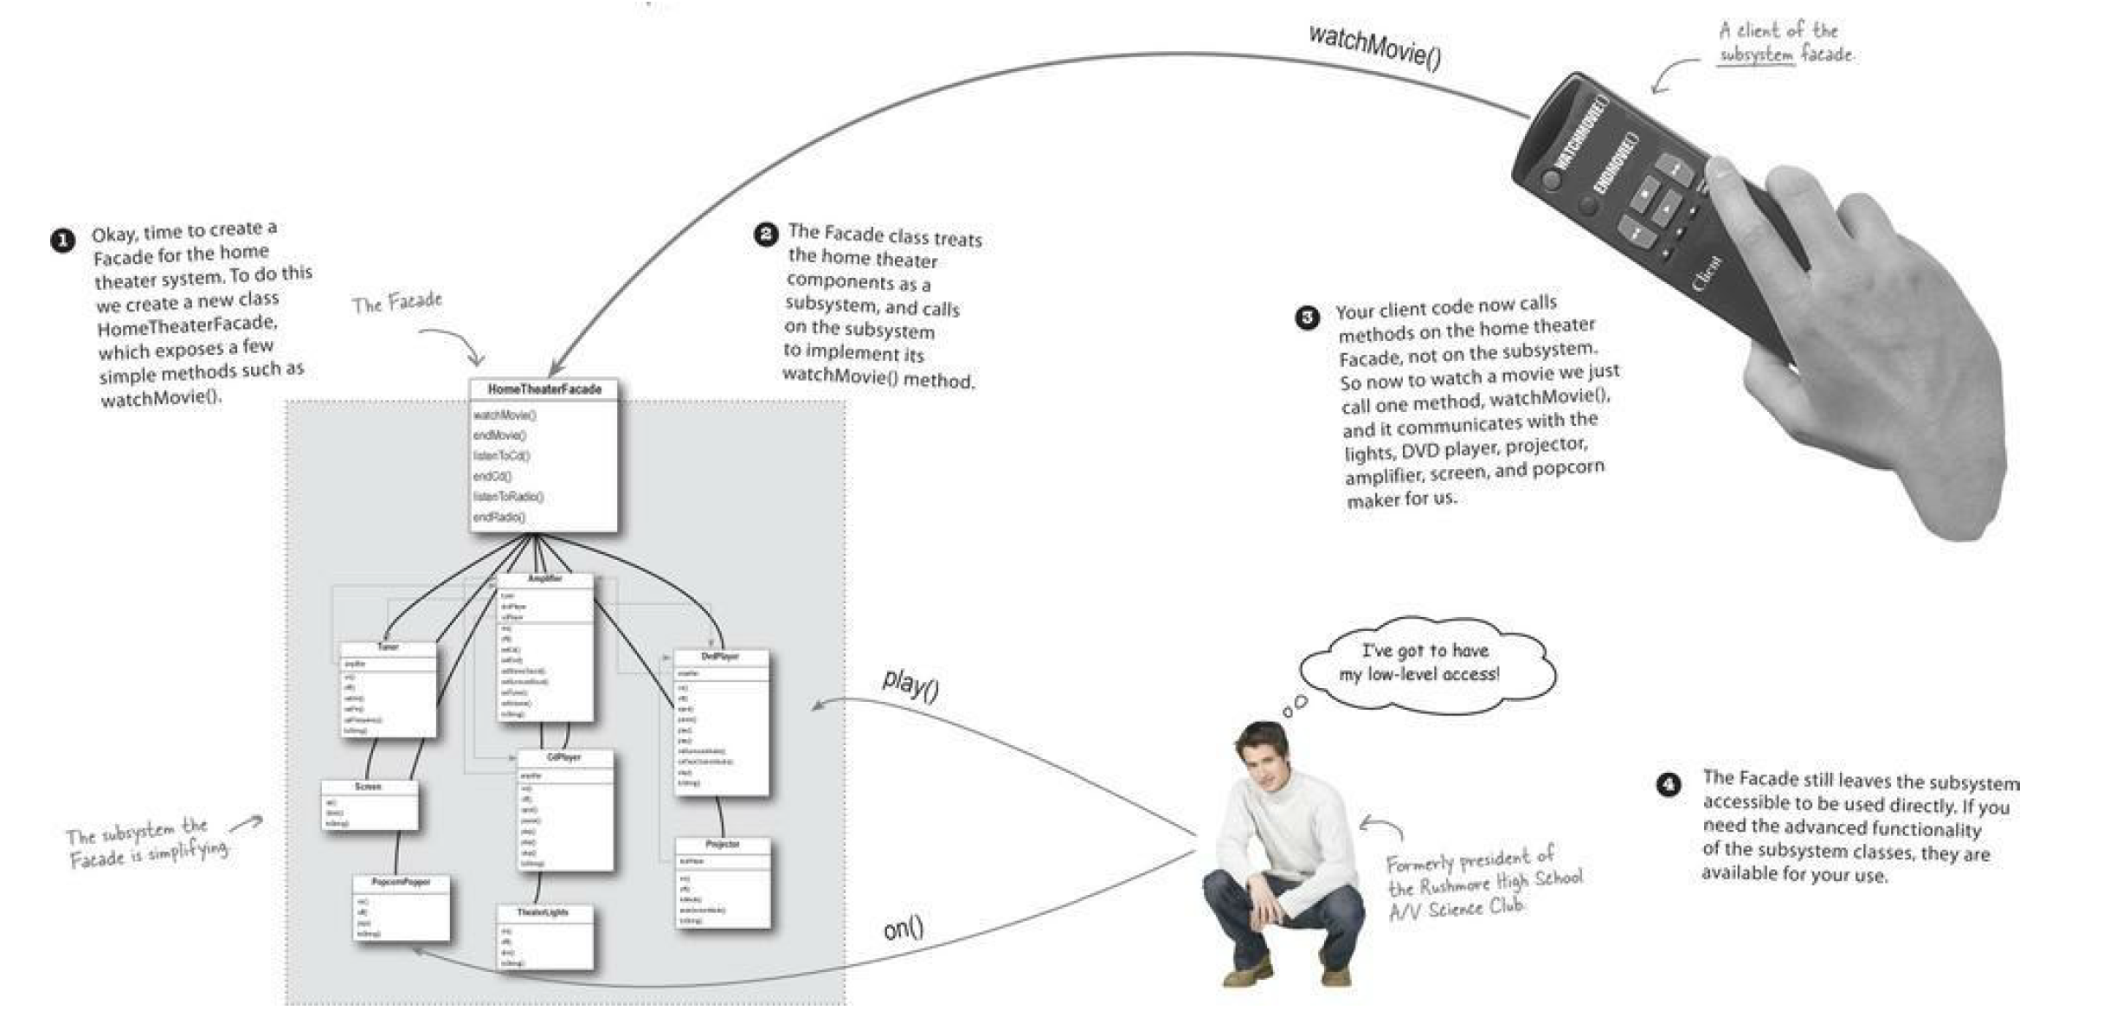
Example (Cont’d)

Slide 10
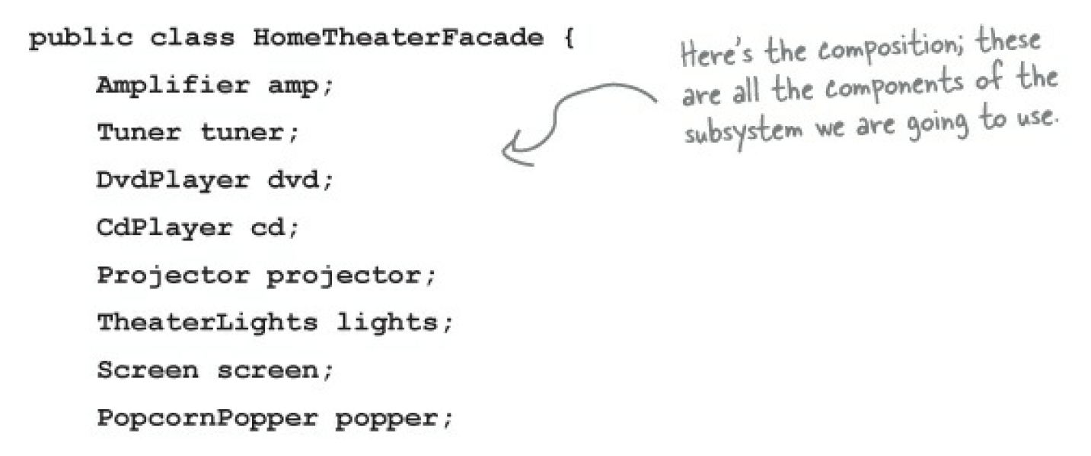
Constructing the façade class
To use composition so that the façade has access to all the components of the subsystem.

Slide 11
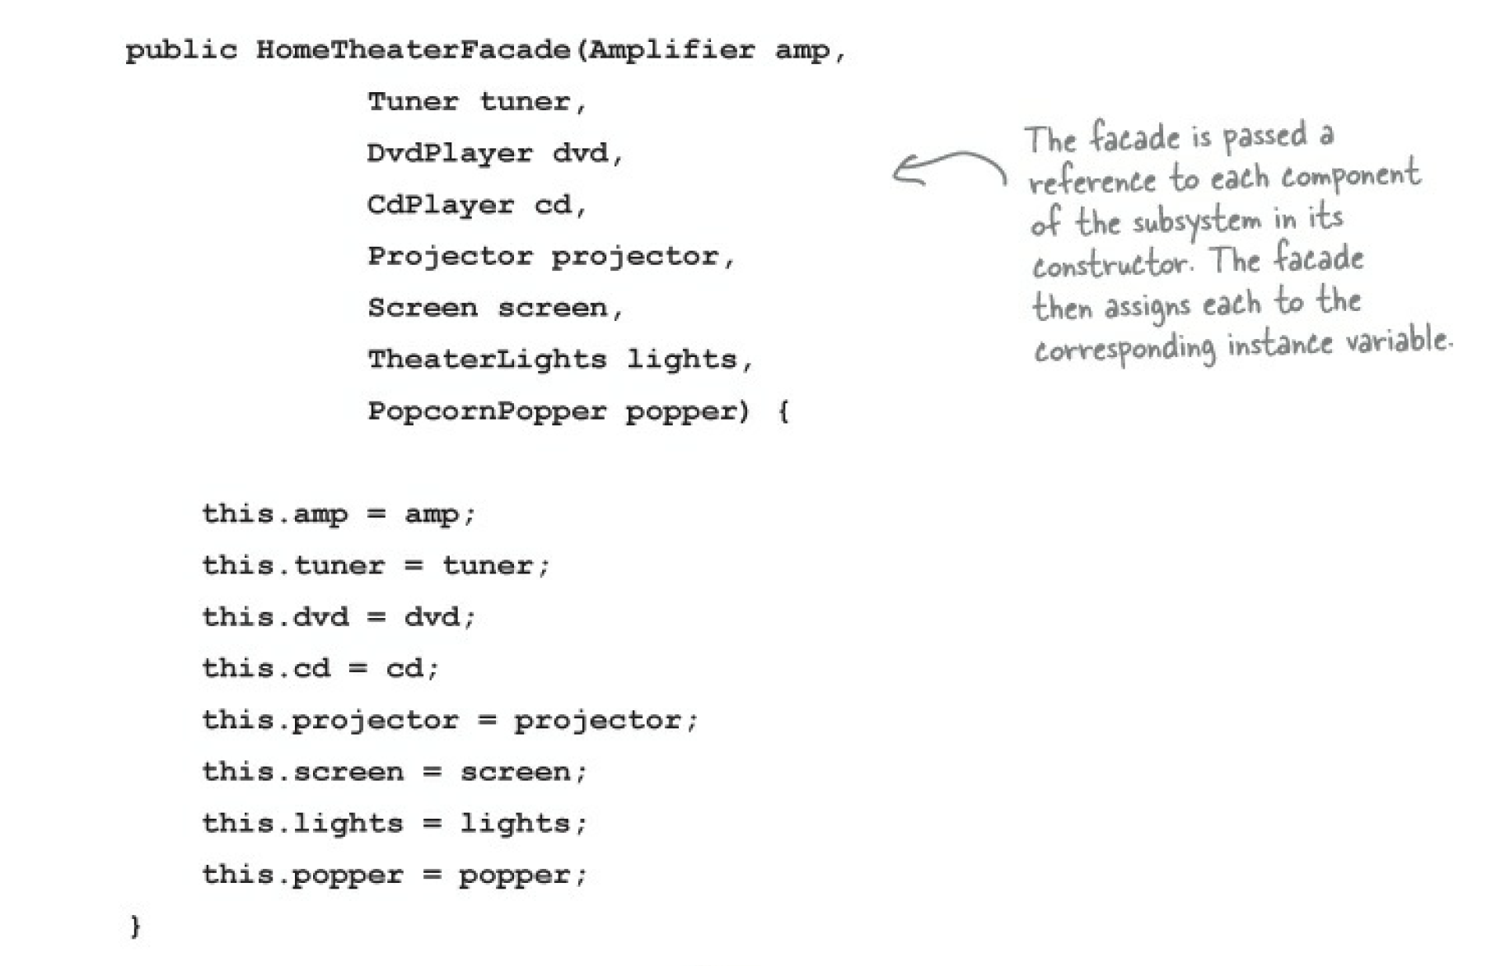
Constructing the façade class

Slide 12
Constructing the façade class
Implement the simplified interface by bringing the components of the subsystem together into a unified interface.
Implement the watchMovie() and endMovie() methods
Notice that each task is delegated to the appropriate component in the subsystem

Slide 13
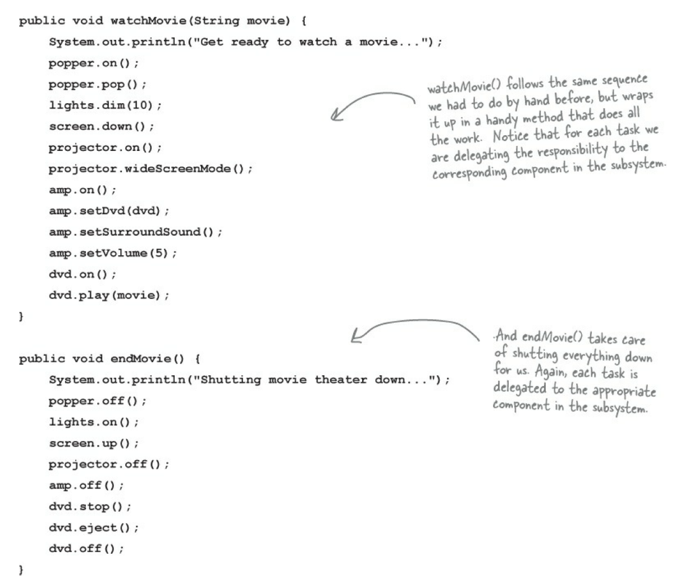
Constructing the façade class

Slide 14
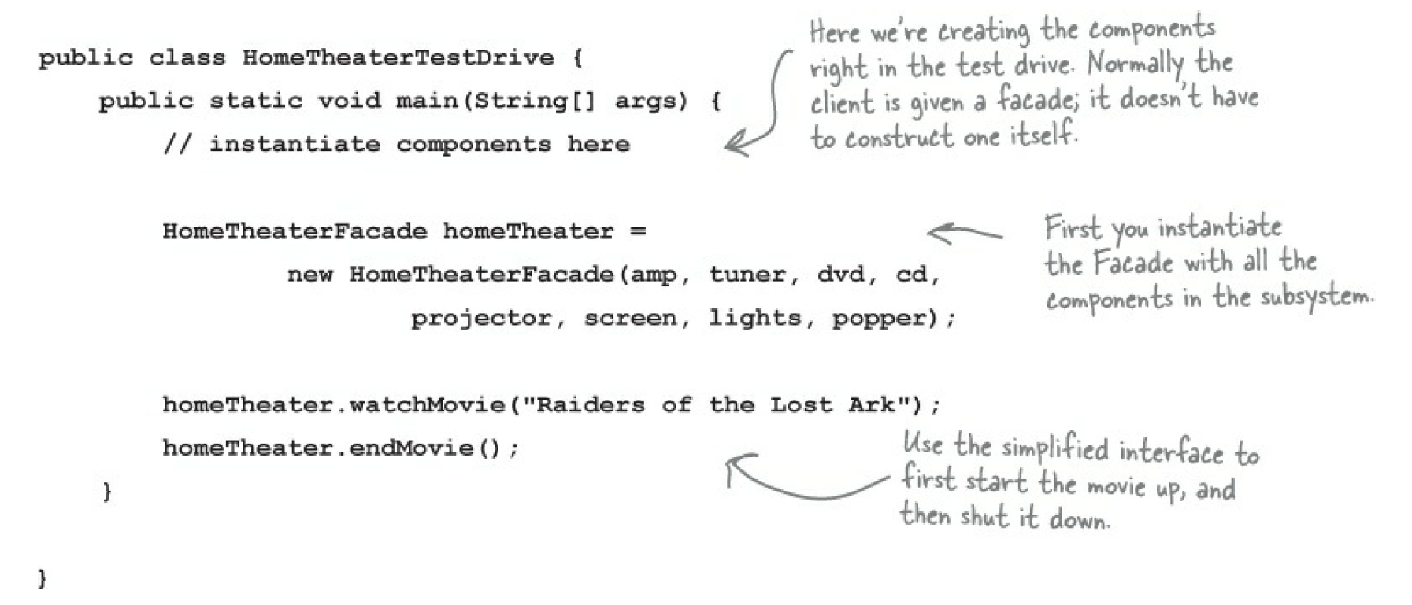
Constructing the façade class
Test out the façade class

Slide 15
Application of façade pattern
When you need to simplify and unify a large interface or complex set of interfaces
Real Life Examples:
Travel Package
Moving a Car

Slide 16
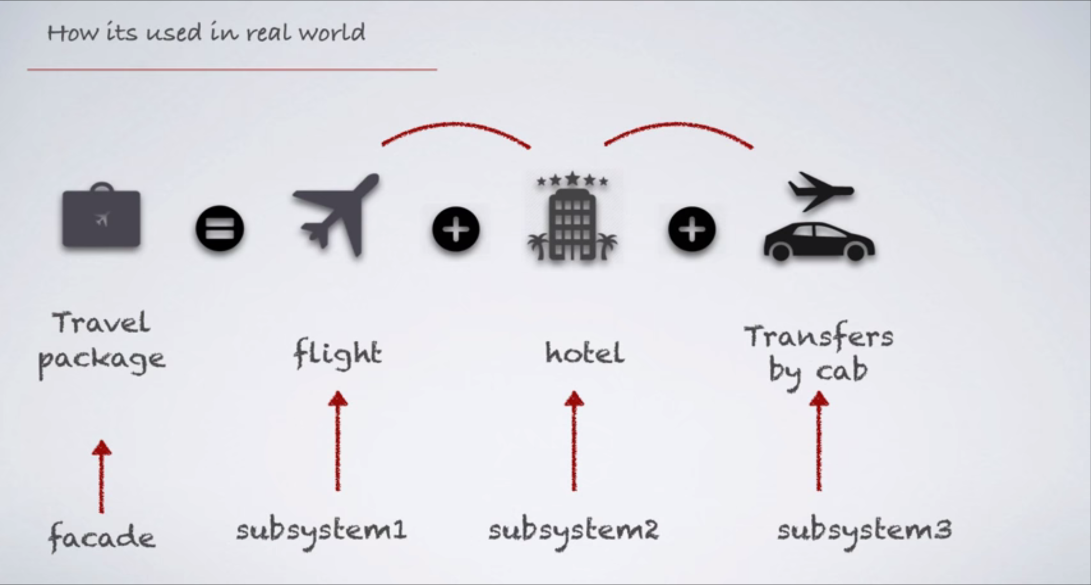
Travel Package

Slide 17
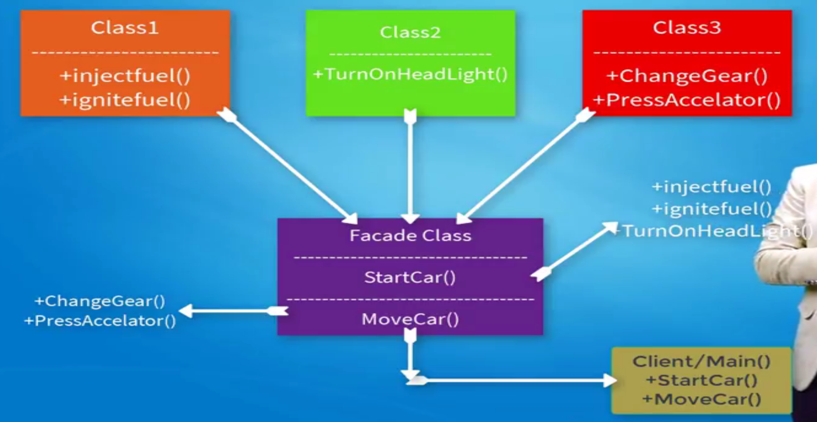
Moving a car

Slide 18
THE END!!
THANK YOU

